Slide 1
UbiCom Book Slides
Chapter 1
Ubiquitous Computing: Basics and Vision
Name:
Email/Web:
Ubiquitous computing: smart devices, environments and interaction

Slide 2
Overview
Living in a Digital World √
Modelling the Key Ubiquitous Computing Properties
Ubiquitous System Environment Interaction
Architectural Design for UbiCom Systems: Smart DEI Model
Course Outline
Ubiquitous computing: smart devices, environments and interaction

Slide 3
Ubiquitous Computing (UbiCom)
A vision for computing to:
  Enable computer-based services to be made available everywhere (Ubiquitous)
  Support intuitive human usage
  But yet, appear to be invisible to the user.
  Also referred to as pervasive computing etc
Ubiquitous computing: smart devices, environments and interaction

Slide 4
Living in an Increasingly Digital, Interconnected World
What are the current technology trends in UbiCom?
Ubiquitous computing: smart devices, environments and interaction

Slide 5

Trend: smaller, higher resource devices
Ear/microphone
Communicator
Display
AV-recorder
Ubiquitous computing: smart devices, environments and interaction

Slide 6
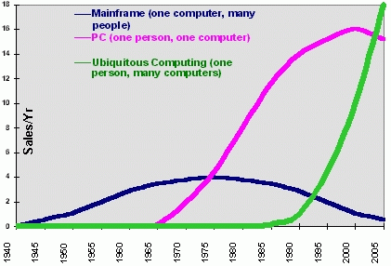
Trend: Weiser’s 3 waves of computing
Ubiquitous computing: smart devices, environments and interaction

Slide 7
Living in an Increasingly Digital, Interconnected World
What will the future be like?
Ubiquitous computing: smart devices, environments and interaction

Slide 8
Scenarios
4 scenarios illustrate a range of benefits and challenges of ubiquitous computing:
Personal memories
21st Century Scheduled Transport Service
Foodstuff management
Utility regulation
N.B. many other scenarios & applications given later
e.g., Chapter 2 describes some key projects and gives an overview of applications.
Ubiquitous computing: smart devices, environments and interaction

Slide 9
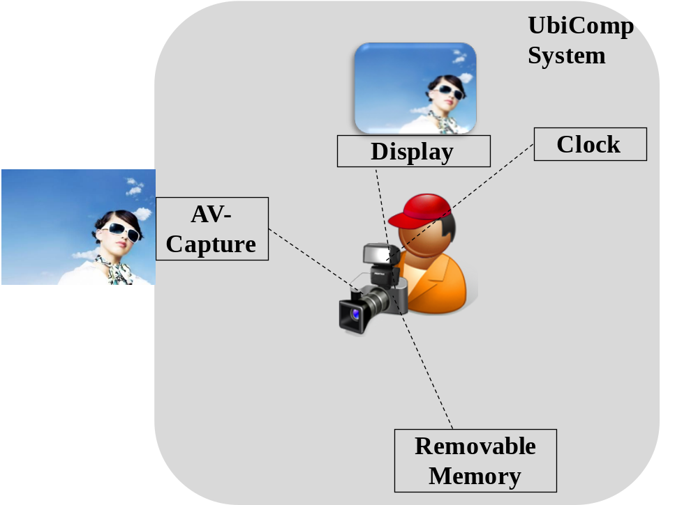
Personal Memories Scenario
Ubiquitous computing: smart devices, environments and interaction

Slide 10
Personal Memories Scenario
How can we enhance the personal memories service using UbiCom?
Ubiquitous computing: smart devices, environments and interaction

Slide 11
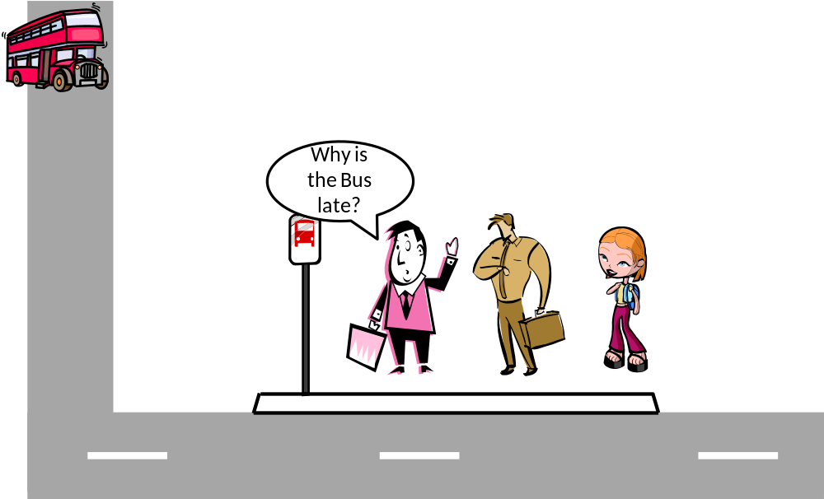
21st Century Scheduled Transport Service Scenario
Ubiquitous computing: smart devices, environments and interaction

Slide 12
21st Century Scheduled Transport Service
How can we enhance the transport service using UbiCom?
Ubiquitous computing: smart devices, environments and interaction

Slide 13
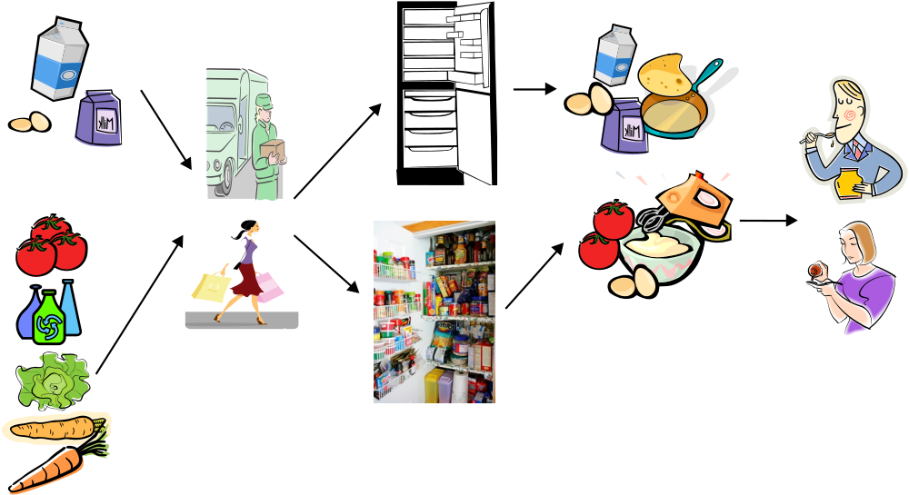
Foodstuff Management Scenario
Select & Buy food at physical or virtual market
Transport food to home store
Put in home store
Select food from store, get & transform food into a meal
Consume food
Ubiquitous computing: smart devices, environments and interaction

Slide 14
Foodstuff Management Scenario
How can UbiCom enhance the foodstuff management scenario?
Ubiquitous computing: smart devices, environments and interaction

Slide 15
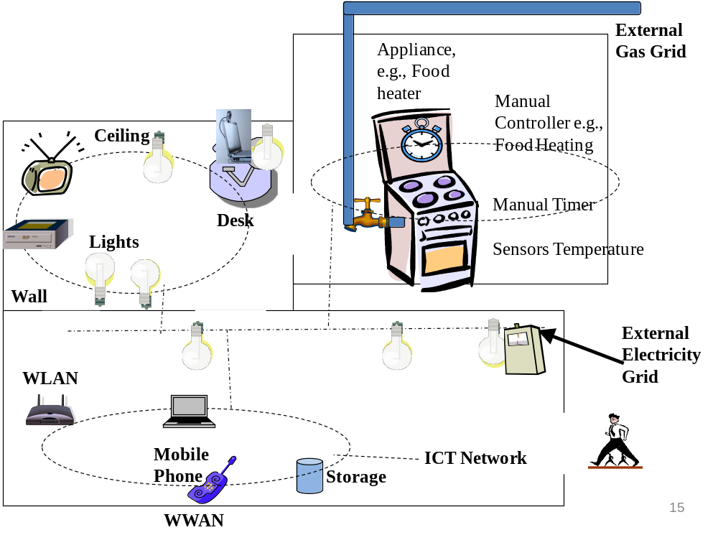
Utility Regulation
Scenario
Ubiquitous computing: smart devices, environments and interaction

Slide 16
Utility Regulation Scenario
Utility regulation concerns energy, water, waste regulation by end-users.
How can UbiCom enhance the Utility Regulation scenario?
Ubiquitous computing: smart devices, environments and interaction

Slide 17
UbiCom System Design
For these scenarios
Which system designs should be used for:
  comms., data storage, processing, sensing, control etc
How to model system - physical world interaction?
How to model human computer system interaction?
These are covered later in this course.
Ubiquitous computing: smart devices, environments and interaction

Slide 18
Overview
Living in a Digital World
Modelling the Key Ubiquitous Computing Properties √
Ubiquitous System Environment Interaction
Architectural Design for UbiCom Systems: Smart DEI Model
Course Outline
Ubiquitous computing: smart devices, environments and interaction

Slide 19
UbiCom: Different Combinations of Core Properties versus a Single Definition
No single, absolute definition for ubiquitous computing.
Instead propose many different kinds of UbiCom based upon combining different sets of core properties
What core system properties would you propose to define ubiquitous computing?
.
Ubiquitous computing: smart devices, environments and interaction

Slide 20
UbiCom: Weiser’s 3 Internal System Properties
3 main properties for UbiCom Systems were proposed by Weiser (1991)
Computers need to be networked, distributed and transparently accessible
  In1991, little wireless computing, Internet far less pervasive
Computer Interaction with Humans needs to be more hidden
  Because much HCI is overly intrusive
Computers need to be aware of environment context
  In order to optimise their operation in their physical & human environment.
Ubiquitous computing: smart devices, environments and interaction

Slide 21
Devices: Extended set of Internal System Properties
To which two additional properties are added:
Computers can operate autonomously, without human intervention, be self-governed
Computers can handle a multiplicity of dynamic actions and interactions, governed by intelligent decision-making and intelligent organisational interaction. This entails some form of artificial intelligence.
Ubiquitous computing: smart devices, environments and interaction

Slide 22
UbiCom: Different Combinations of Core Properties versus a Single Definition
No single, absolute definition for ubiquitous computing.
Instead propose many different kinds of UbiCom based upon combining different sets of core properties
Here are some examples proposed by others
Weiser (1991): distributed, iHCI, physical environment context aware
Ambient Intelligence (AmI), similar to UbiCom - intelligence everywhere?
  Arts and Marzano (2003) define 5 key features for AmI to be embedded, context-aware, personalised, adaptive and anticipatory.
Buxton (1995): ubiquity and transparency
Endres et al. (2005): distributed mobile, intelligence, augmented reality
Millner (2006): autonomy, IHCI
Etc.
Exercise: Do your own survey of UbiCom definitions and highlight the properties they define.
.
Ubiquitous computing: smart devices, environments and interaction

Slide 23
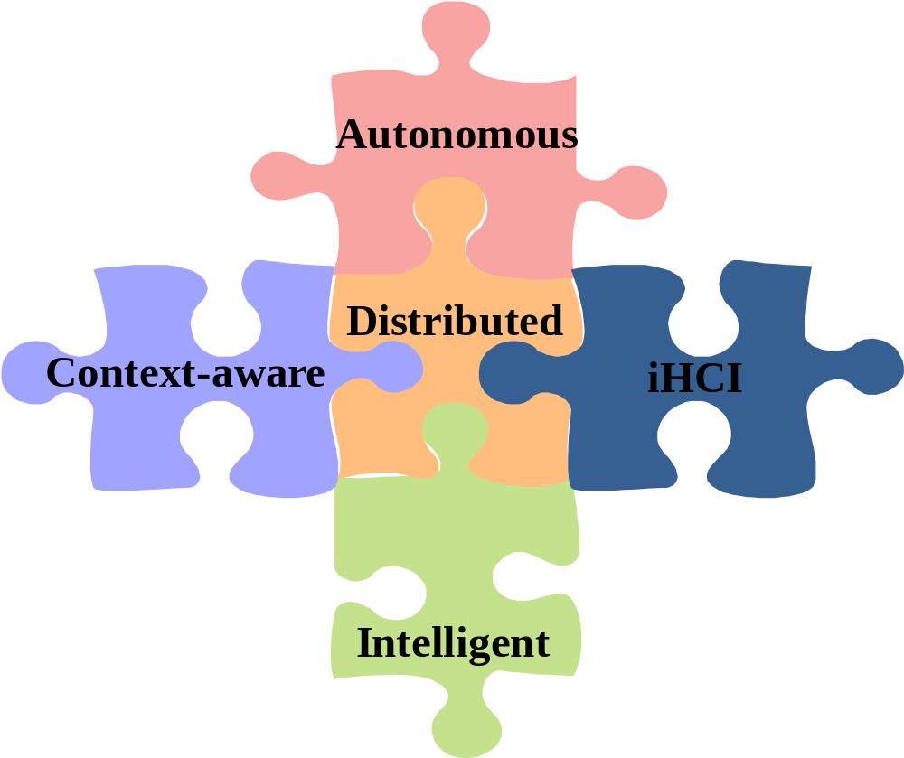
Five main properties for UbiCom
Ubiquitous computing: smart devices, environments and interaction

Slide 24
UbiCom System Properties: Distributed
Networked ICT Devices
Transparency
Openness
Ubiquitous computing: smart devices, environments and interaction

Slide 25
Distributed System: sub-properties
Often designed middleware, set of generic services
Universal, Seamless, Heterogeneous
Networked
Synchronised, Coordinated
Open
Transparent, Virtual
Mobile, Nomadic
(See Chapters 3 and 4)
Ubiquitous computing: smart devices, environments and interaction

Slide 26
Internal System Properties: iHCI
Concept of calm / disappearing computer has several dimensions
Implicit (iHCI) versus Explicit HCI
Embodied Virtuality as opposite of VR (people in virtual world)
Ubiquitous computing: smart devices, environments and interaction

Slide 27
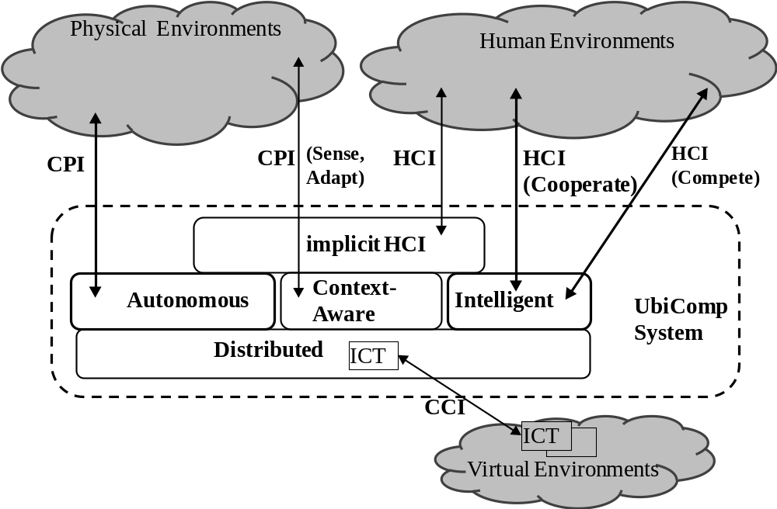
Devices: Extended set of Internal System Properties
Ubiquitous computing: smart devices, environments and interaction

Slide 28
iHCI: Sub-Properties
Implicit Human Device Interaction (iHCI)
Non-intrusive, Hidden, Invisible, Calm, computing
Tangible, Natural
Anticipatory, Speculative, Proactive
Affective, Emotive
User-aware
PostHuman
Sense of Presence
Immersed, Virtual , Mediated reality
(See chapter 5)
Ubiquitous computing: smart devices, environments and interaction

Slide 29
Internal System Properties: context-aware
Often Context-based ubiquity rather than global ubiquity
  Why?
3 Main Types of Context
Physical Environment Context
Human Context (or User context or person context)
ICT Context or Virtual Environment Context:
Ubiquitous computing: smart devices, environments and interaction

Slide 30
Context-aware: sub-properties
Also referred to as Sentient, Unique, Localised, Situated
Presupposes sensing of environment to be aware of its context
Adaptive: active versus passive context-aware
Types of environment aware
Person-aware, User-aware, Personalised, Tailored,
Environment-aware, Context-aware, Physical context-aware
ICT infrastructure aware
(See Chapter 7)
Ubiquitous computing: smart devices, environments and interaction

Slide 31
Internal System Properties: Autonomy
Challenge 1: increasing computer systems can overload humans – humans become a bottleneck
What can be done?
Ubiquitous computing: smart devices, environments and interaction

Slide 32
Internal System Properties: Autonomy
Challenge 2: automated system can be become to complex to maintain
  - must reduce maintenance of ↑ complex systems
What can be done?
Ubiquitous computing: smart devices, environments and interaction

Slide 33
Autonomy: Sub-Properties
Automatic
Embedded, Encapsulated
Embodied
Resource-constrained
Untethered, Amorphous
Autonomic, Self-managing, self-star properties
Emergent, self-organising
(See Chapter 10)
Ubiquitous computing: smart devices, environments and interaction

Slide 34
Internal System Properties: Intelligence
Intelligent UbiCom systems (IS) can:
Act more proactively, dynamically & humanely through:
Model how their environment changes when deciding how it acts.
Goal-based / planning
Reasoning for re-planning
Handle uncertainty.
semantic based interaction
etc
Ubiquitous computing: smart devices, environments and interaction

Slide 35
Individual Intelligence: Sub-Properties
Referred to as Intelligent Systems, AI, agent-based system etc.
Sub-Properties (sub-types of individual intelligence)
Reactive, Reflex
Model-based,
Rule/Policy-based
Logic/Reasoning
Goal-oriented, Planned, Proactive
Utility-based, Game theoretic
Learning, Adaptive
(See Chapter 8)
Ubiquitous computing: smart devices, environments and interaction

Slide 36
Multiple Intelligence: Sub-Properties
Referred to as Distributed AI, Multi-Agent Systems, Collective or Social Intelligence
Sub-Properties
Cooperative , Collaborative, Benevolent
Competitive, self-interested, antagonistic, adversarial
Orchestrated, Choreographed, Mediated
Task-sharing
Communal, shared meaning
Shared knowledge
Speech-act based , Intentional, Mentalistic
(See Chapter 9)
Ubiquitous computing: smart devices, environments and interaction

Slide 37
Overview
Living in a Digital World
Modelling the Key Ubiquitous Computing Properties
Ubiquitous System Environment Interaction √
Architectural Design for UbiCom Systems: Smart DEI Model
Course Outline
Ubiquitous computing: smart devices, environments and interaction

Slide 38
UbiCom System versus ICT System focus
Conventional focus on ICT systems
Systems situated in a virtual world, in an environment of other ICT systems -> a system of ICT systems
Conventional use a restrict view of physical environment interaction:
Conventional ICT systems often require humans in the loop
UbiCom represents a powerful shift in computation:
Ubiquitous computing: smart devices, environments and interaction

Slide 39
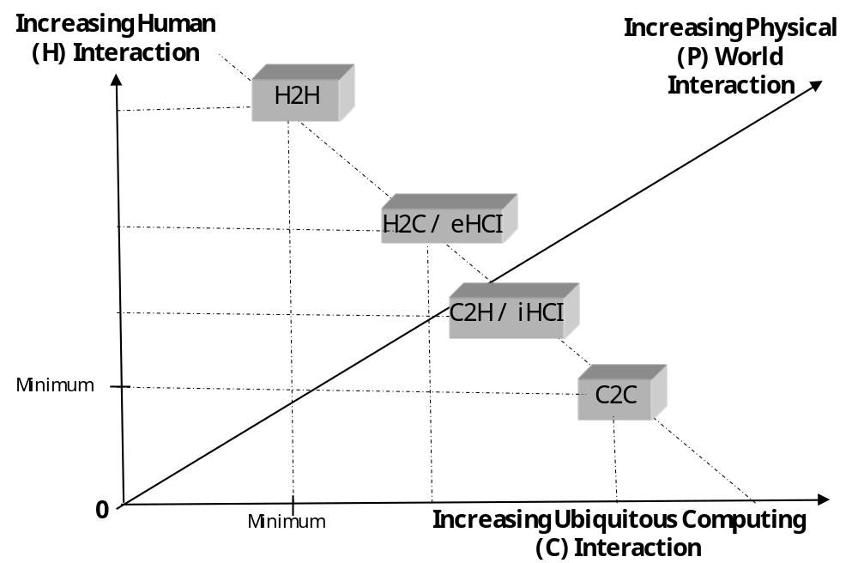
Different Degrees of HCI
Ubiquitous computing: smart devices, environments and interaction

Slide 40
Different Degrees of HCI
From less to more C Interaction with H
H2H: human interaction
H2C or explicit (e)HCI:
C2H or implicit (i)HCI:
C2C:
Ubiquitous computing: smart devices, environments and interaction

Slide 41
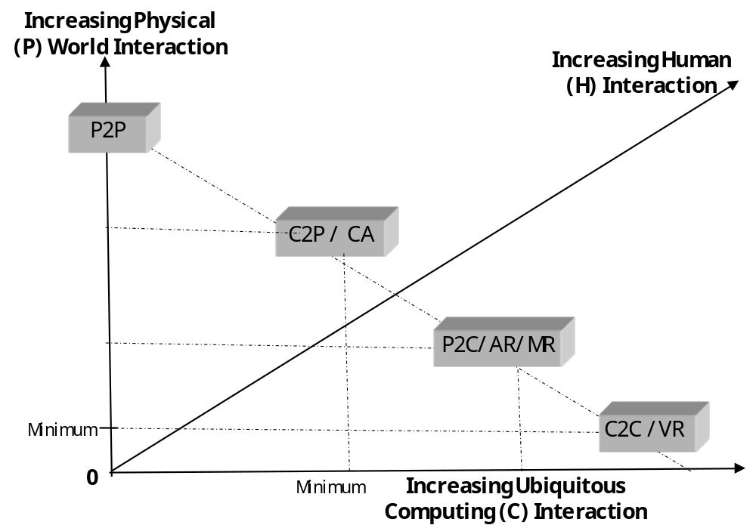
Different Degrees of CPI
Ubiquitous computing: smart devices, environments and interaction

Slide 42
Different Degrees of CPI
From less to more C Interaction with P
P2P
  Physical interaction (No ICT mediation)
C2P / CA (Physical Env. Context-aware)
  C Senses P. C Aware of P’s Context
P2C/AR/MR
  C augments or mediates P’s reality.
  C actively adapts to P’s context
C2C /VR
  Virtualisation of reality facilitated by C
Ubiquitous computing: smart devices, environments and interaction

Slide 43
Overview
Living in a Digital World
Modelling the Key Ubiquitous Computing Properties
Ubiquitous System Environment Interaction
Architectural Design for UbiCom Systems: √
Course Outline
Ubiquitous computing: smart devices, environments and interaction

Slide 44
UbiCom System Model: Smart DEI
No single type of UbiCom system
Different UbiCom systems support:
3 basic architectural design patterns for UbiCom:
  smart Devices, smart Environments, smart Interaction
‘Smart’ means systems are:
  active, digital, networked, autonomous, reconfigurable, local control of its own resources, e.g., energy, data storage etc.
Ubiquitous computing: smart devices, environments and interaction

Slide 45
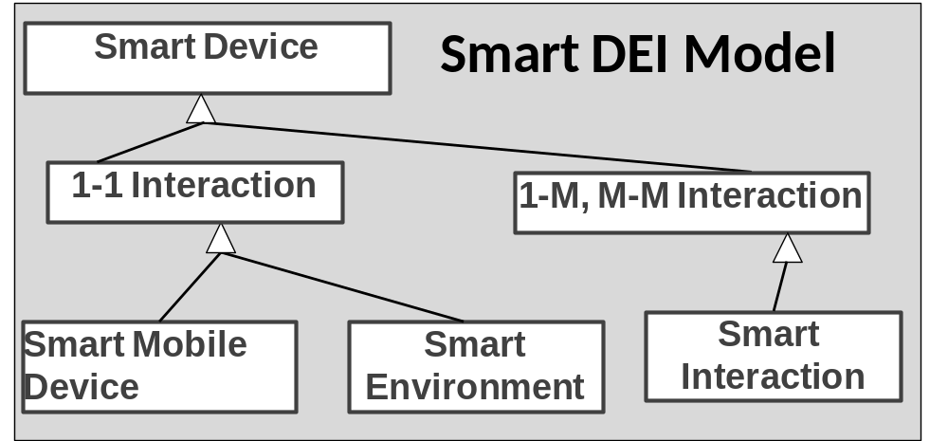

Slide 46
UbiCom System Model: Smart DEI
Device Trends
Increasing capability to embed devices in the physical environment
Increasing capability for more interoperable distributed mobile devices
Increasing capability to manufacture low power, micro, more complex devices
Use more complex, multi-functional, mobile, personalised (& private) smart devices to ease access to & embody services rather than just to virtualise them
Use smarter environments to sense and react to events such as people, with mobile devices , entering & leaving controlled spaces
Use more service access devices with simpler functions and allow them to interoperate – smarter interaction between devices
e.g., walls can sense camera is recording and modify lighting to improve recording
e.g., camera can interconnect to phone to share recordings, direct to printer to print
e.g., phone is also a camera, music player, is also a printer??
Ubiquitous Computing
Ubiquitous computing: smart devices, environments and interaction

Slide 47
Smart DEI Model: types of smart device
3 main types of UbiCom system may themselves contain smart sub-systems at a lower level of granularity
  e.g., a smart environment device may consist of smart sensors and smart controllers
Ubiquitous computing: smart devices, environments and interaction

Slide 48
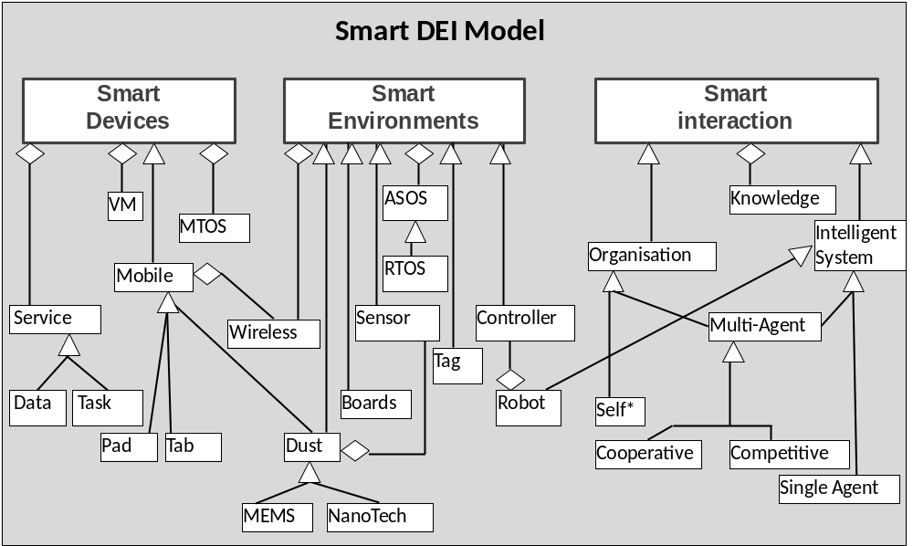
UbiCom System: Smart Sub-Systems or Components
Ubiquitous computing: smart devices, environments and interaction

Slide 49
Smart Device Form Factors
Devices tend to become smaller and lighter in weight, cheaper to produce.
Devices can become prevalent, made more portable and can appear less obtrusive.
Weiser proposed a range of device sizes
Smart Tabs
Smart Pads:
Smart Boards:
Ubiquitous computing: smart devices, environments and interaction

Slide 50
Smart Device Form Factors (2)
Form Factors can be extended to support
Smart Dust
Smart Skins
Smart Clay
(See Chapters 5,6)
Ubiquitous computing: smart devices, environments and interaction

Slide 51
Design challenges in Using Varying Form Factors
What are the design Challenges?
Ubiquitous computing: smart devices, environments and interaction

Slide 52
Smart Device: Variations
Many variations or sub-types of smart devices,
  e.g. smart mobile device, smart environment device
  Use different combinations of sub-components
  Support different combinations of UbiCom properties
  Interact in different types of environment
  Take different form factors
Ubiquitous computing: smart devices, environments and interaction

Slide 53
Smart Device Variations: Smart Mobile Device
Many flavours or variants of these basic designs
One of the most important variants of the smart device is the smart mobile device
Combines several main types of UbiCom property:
Note mobile devices are sometimes taken to be synonymous with wireless devices but these are different (see Chapter 11
Ubiquitous computing: smart devices, environments and interaction

Slide 54
Smart Mobile Devices
Multi-purpose ICT devices, operating as a single portal to multiple services
eases access & interoperability versus decreased openness
Usually personalised devices, specified owner.
Locus of control and user interface resides in the smart device.
Main characteristics: mobility, open service discovery, intermittent resource access.
Ubiquitous computing: smart devices, environments and interaction

Slide 55
Smart Devices: Mobility
Many dimensions for mobility
Static:
Accompanied:
Wearable:
Embedded (into objects):
Implanted (into humans):
Untethered or unanchored:
Division between statics and mobiles can be more finely grained and multi-dimensional (see Chapter 4)
Ubiquitous computing: smart devices, environments and interaction

Slide 56
Volatile Service Access
Devices access software services and hardware intermittently . Why?
Devices can dynamically discover services available.
Context-aware discovery can improve basic discovery.
Asymmetric remote service access, more downloads than uploads, tends to occur.
Ubiquitous computing: smart devices, environments and interaction

Slide 57
Smart Mobile Devices: Context-Aware
Can use contexts to filter information & service access.
Often designed to work with a reference location in physical environment called a home location,
Mobile devices are ICT resource constrained.
Mobile devices tend to use a finite internal energy cache.
Devices’ configuration, operation tends to be personalised
Ubiquitous computing: smart devices, environments and interaction

Slide 58
Smart Environment (Devices)
Definitions
Consists of a set of smart devices specialised to interact with their (virtual, phys., human) environments.
Typically, embedded single task devices; not MTOS devices
Can automatically respond to or anticipate users, using iHCI
Smart environments support bounded, local user context
Smart environment devices may also be:
  fixed versus anchored mobile versus unanchored mobile devices
  macro to micro to nano
Smart environment device design issues what?
  See Chapter 6, 7
Smart environment device management issues what?
  See Chapter 12
Ubiquitous computing: smart devices, environments and interaction

Slide 59
Types of Smart Environment Device Interaction
Tagging and Annotating
Sensing & monitoring
Filtering
Adapting
Controlling
  Assembling
  Regulating
Ubiquitous computing: smart devices, environments and interaction

Slide 60
Smart Interaction
Additional type of design is needed to knit together many individual system components and interactions.
Smart interaction promotes unified & continuous interaction model between UbiCom applications & their UbiCom infrastructure, physical world & human environments.
Internal self-organising system vs. externally driven system
Components can interact cooperatively versus competitively
Several benefits to designs based upon set of interacting components:
A range of levels of interaction between UbiCom System components
Distinguish between (basic) interaction and (smart) interaction
Ubiquitous computing: smart devices, environments and interaction

Slide 61
Basic Interaction
Typically involves two interlinked parties, a sender and a receiver.
Sender knows things in advance:
Two main types of basic interaction synchronous versus asynchronous
(Chapter 11)
Ubiquitous computing: smart devices, environments and interaction

Slide 62
Smart Interaction
Smart Interaction extends basic interactions as follows.
Coordinated interactions
Cooperative versus competitive interaction
Policy and Convention based Interaction
Dynamic Organisational Interaction
Semantic and Linguistic Interaction
(See Chapter 9)
Ubiquitous computing: smart devices, environments and interaction

Slide 63
Smart DEI Model Summary
Basic Smart Device has many variations
  6 different physical form factors
  5 different groups of internal properties & over 70 sub-properties
Multiple flavours of smart device,
  e.g., Smart Mobile type of Smart device
  e.g., Smart Environment type of Smart Device
UbiCom System interact across 3 main types of environment: physical, virtual & human
System of systems models in terms of multiple device combinations and interactions
Ubiquitous computing: smart devices, environments and interaction

Slide 64
Common Myths of Ubiquitous Computing
There is a single definition which will accurately characterises Ubiquitous Computing
The ideal type of Ubiquitous computing is where all the properties of ubiquitous must be fully supported
Ubiquitous computing means making computing services accessible everywhere.
Ubiquitous computing is boundless computing
Ubiquitous computing is just about HCI
Calm Computing should be used as a model for all HCI.
Ubiquitous computing is just about augmenting reality
Ubiquitous computing: smart devices, environments and interaction

Slide 65
Common Myths of Ubiquitous Computing 2
Ubiquitous computing is just distributed or virtual computing
Ubiquitous computing is just mobile wireless computing
Ubiquitous computing is just about smart environments
Ubiquitous computing need to be highly autonomous systems
Ubiquitous computing is just about physical world context-awareness
Ubiquitous computing is just distributed intelligence
Ubiquitous computing systems can operate effectively in all kinds of environments:
Ubiquitous computing: smart devices, environments and interaction

Slide 66
Overview
Living in a Digital World
Modelling the Key Ubiquitous Computing Properties
Ubiquitous System Environment Interaction
Architectural Design for UbiCom Systems: Smart DEI Model
Course Outline √
Ubiquitous computing: smart devices, environments and interaction

Slide 67
Organisation of UbiCom Course Book: Chapter Comparison
No | Section Title | DEI | UbiCom Property | Environment Interactions
1 | Vision and Basics Concepts | DEI | All | All
2 | Applications and Requirements | DEI | Distributed, iHCI, Context-aware | All
3 | Smart Devices and Services | Devices | Distributed | C2C
4 | Smart Mobile Devices, Device Networks and Smart Cards | Devices | Distributed | C2C
5 | Human Computer Interaction | Devices | iHCI | HCI
6 | Tagging, Sensing and Controlling | Environment | Context-aware | CPI
7 | Context-Awareness | Environment | Context-aware | CPI
8 | Intelligent Systems | Interaction | Intelligent | C2C, HCI
9 | Intelligent Interaction | Interaction | Intelligent, iHCI | H2H, C2C
10 | Autonomous Systems and Artificial Life | Interaction | Autonomy, Intelligence, | C2C
11 | Communication Networks | Devices | Distributed | C2C
12 | Smart Device Management | Devices | Distributed, iHCI, Context-aware | C2C, HCI, CPI,
13 | Ubiquitous System Challenges and Outlook | DEI | All | All
Ubiquitous computing: smart devices, environments and interaction

Slide 68
Organisation of UbiCom in this Course (Main Sections)
Basics: Vision and Basics Concepts (Chapter 1); Applications and Requirements (Chapter 2);
Smart Devices: Smart Devices and Services (Chapter 3); Smart Mobile Devices, Networks and Cards (Chapter 4); Human Computer Interaction (Chapter 5);
Smart Environments: Tagging, Sensing, Control of the Physical World (Chapter 6); Context-aware Systems (Chapter 7);
Smart Interaction: Intelligent Systems (Chapter 8); Intelligent Interaction (Chapter 9); Autonomous Systems and Artificial Life (Chapter 10).
Middleware and Outlook: Ubiquitous Communication (Chapter 11); Smart Device Management (Chapter 12); Ubiquitous System Challenges and Outlook (Chapter 13).
Ubiquitous computing: smart devices, environments and interaction

Slide 69
Overview
Living in a Digital World √
Modelling the Key Ubiquitous Computing Properties √
Ubiquitous System Environment Interaction √
Architectural Design for UbiCom Systems: Smart DEI Model √
Course Outline √
Ubiquitous computing: smart devices, environments and interaction

Slide 70
Summary & Revision
For each chapter
See book web-site for chapter summaries, references, resources etc.
Identify new terms & concepts
Apply new terms and concepts: define, use in old and new situations & problems
Debate problems, challenges and solutions
See Chapter exercises on web-site
Ubiquitous computing: smart devices, environments and interaction

Slide 71
Exercises: Define New Concepts
Ubiquitous Computing, etc
Ubiquitous computing: smart devices, environments and interaction

Slide 72
Exercise: Applying New Concepts
What are the main properties of UbiCom?
etc
Ubiquitous computing: smart devices, environments and interaction

